Slide 1
The Legend of the Stone Soup:
A Humble Gastronomic Tale About Sharing
Illustrated by Açucena Alijaj

Slide 2
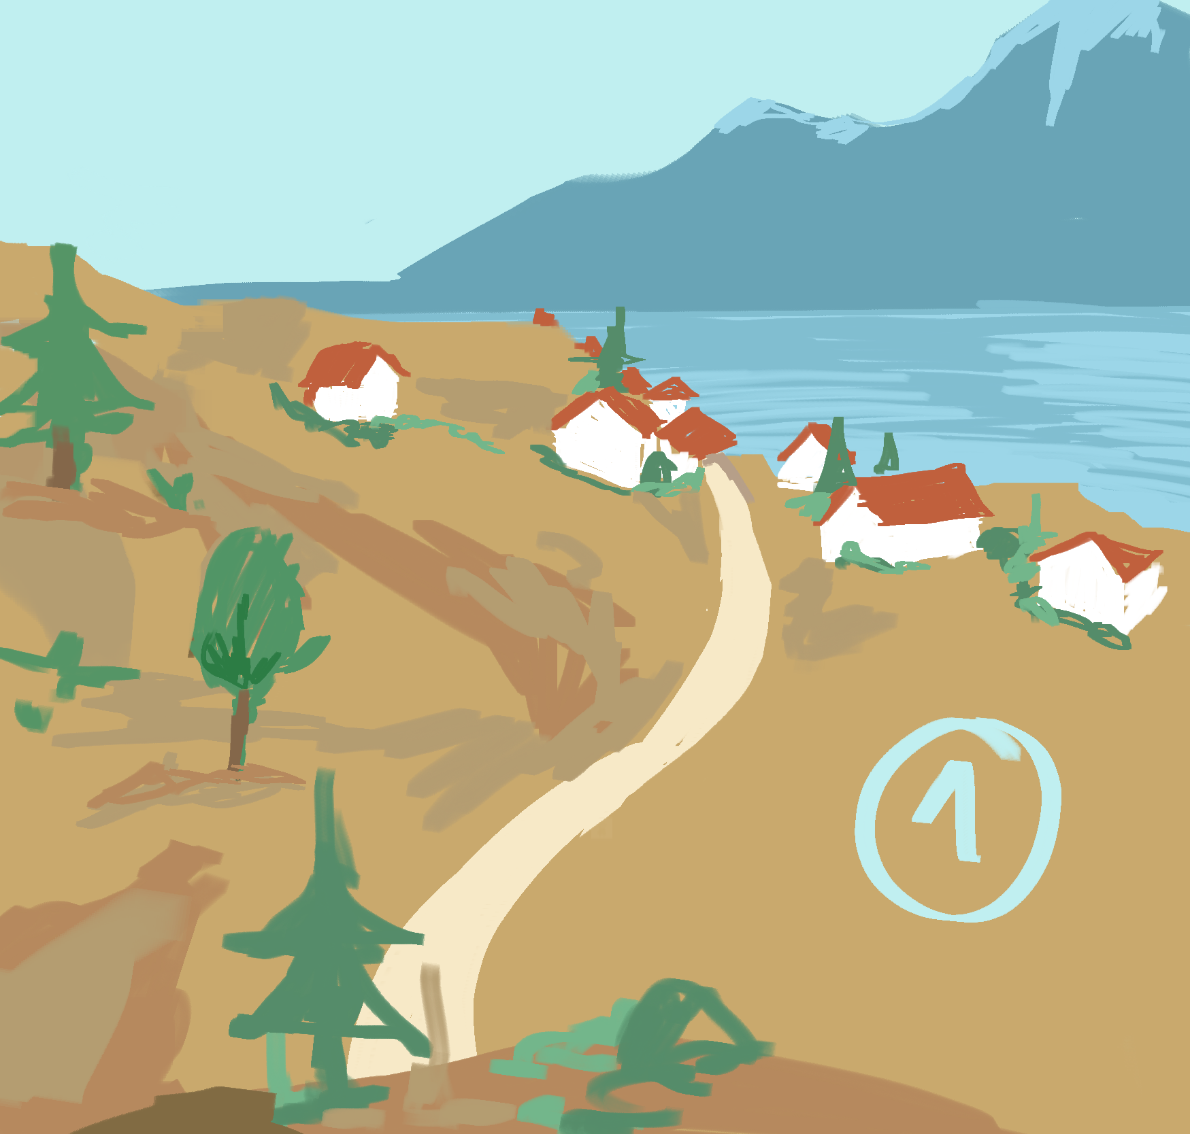
According to the people of Almeirim, a poor friar who was on a pilgrimage stopped in the village and knocked on the door of a house.
As luck would have it, there were people home.
Far too proud to beg for a bite to eat, he instead asked the man behind the door if he could borrow a large pot, in which to make “a delicious and filling sopa de pedra (stone soup)”.

Slide 3
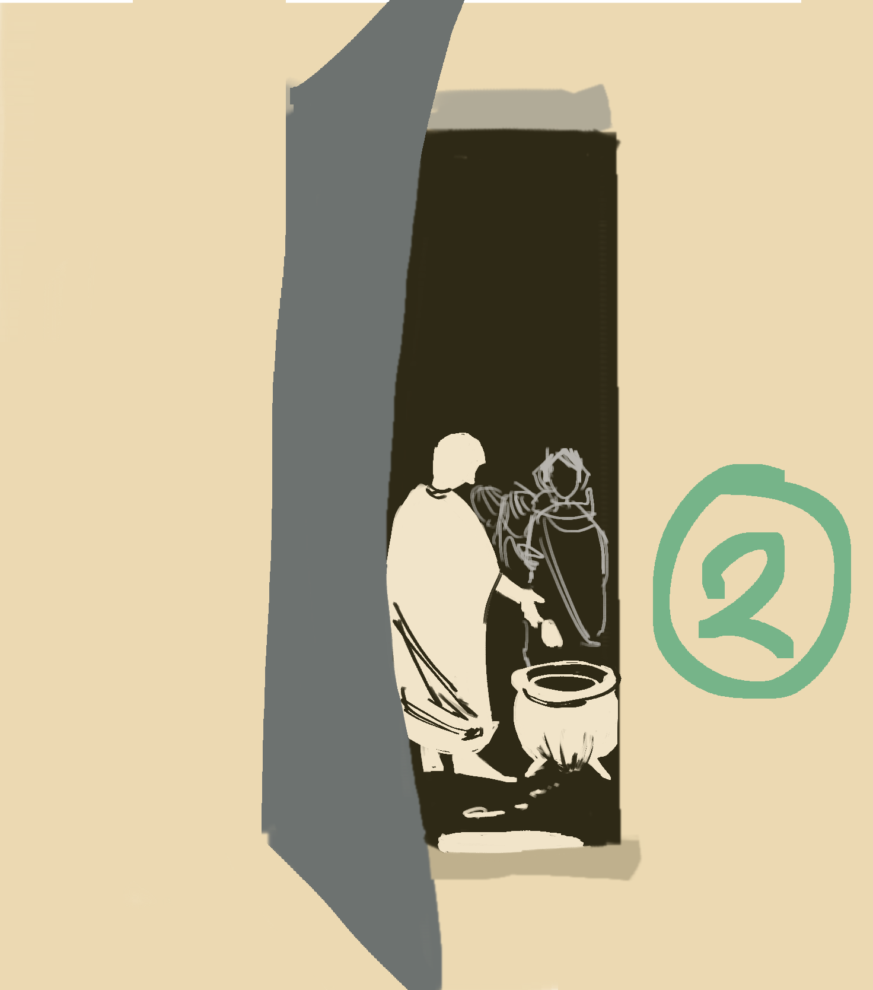
“Stone Soup? How on earth could stone soup be appetizing?” wondered the man.
With arched eyebrows and curious glances, the man and his family invited him into their home and filled up a large pot with water to set over flickering flames.
Slowly walking up to the iron-clad cauldron, the friar reached into his deep pocket and produced a smooth stone that he had found on the ground earlier. He made sure to clean it well, before dropping it into the boiling water. A little while later, he tasted the soup and said it needed a touch of seasoning. So the generous man’s wife brought him some salt to add.

Slide 4
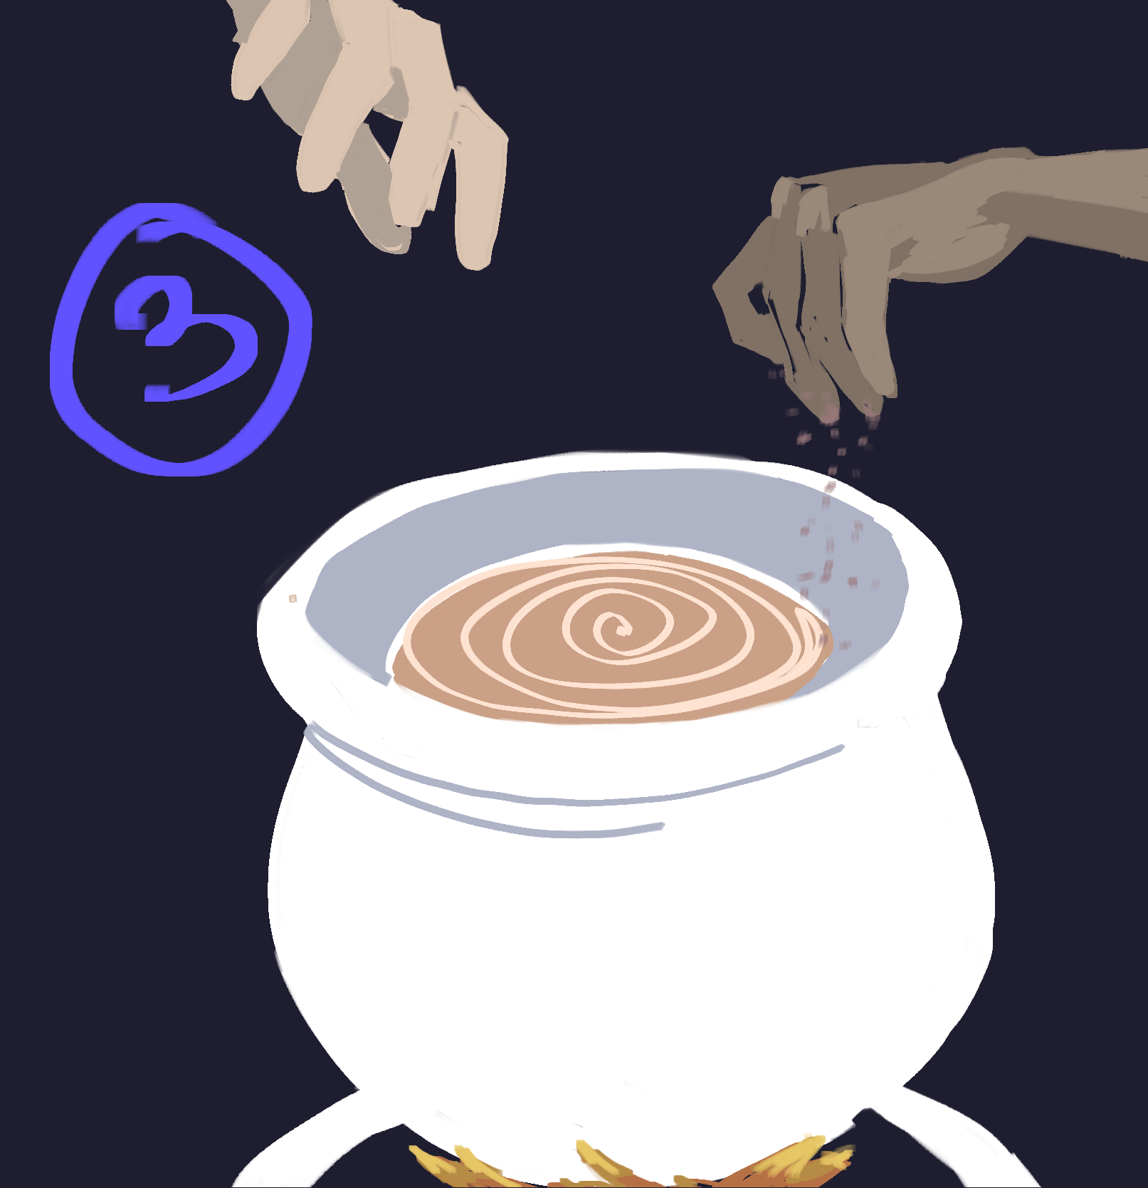
“Why thank you,” the friar said.
However, perhaps a little bit of
chorizo (sausage) would be better.
What do you think?”
Graciously, she obliged and dropped several
thick slices into the pot.
“Now, that certainly tastes better. (…) Would you happen to have any vegetables left over
from an earlier meal?”
With a broad smile, she agreed and
added a healthy portion of
leftovers into the bubbling water.

Slide 5
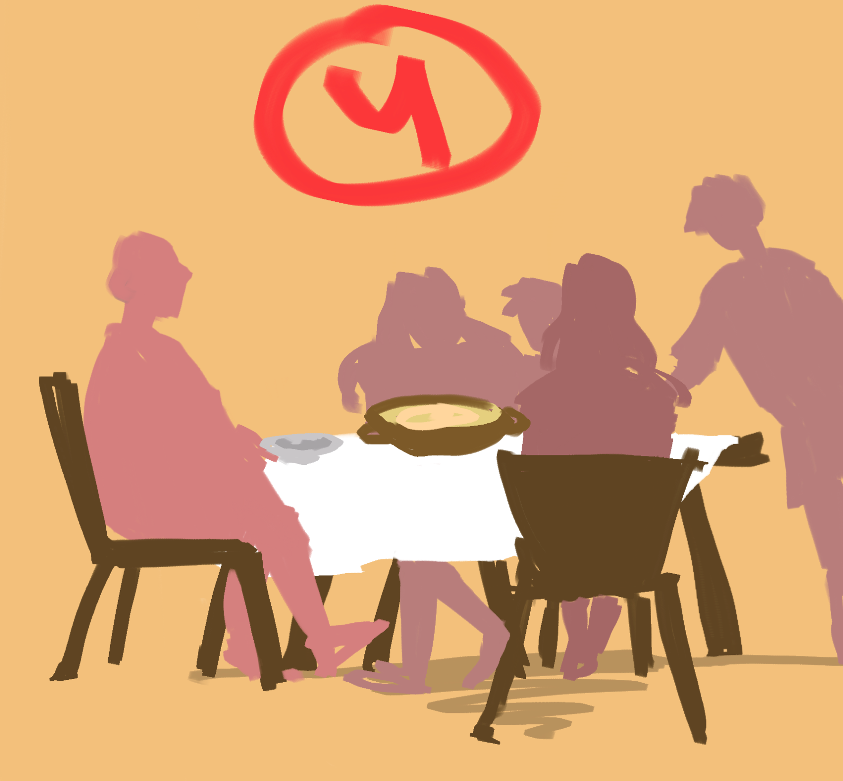
When the soup was done, the friar fished the stone out of the
pot, washed and dried it off, and plopped it back in his pocket
for the next time. He let the family try the soup, and they were amazed and grateful that they had let the friar into their home.
If they hadn’t trusted his abilities in making the stone soup, they would never have enjoyed the best meal of their lives. Yet, the friar believed that if he hadn’t shared his soup with others, it wouldn’t have tasted nearly as good
After all, the food you prepare
tastes only as good as the love
you put in it.

